Slide 1

RadioInstigator
Signals Intelligence Platform

Slide 2

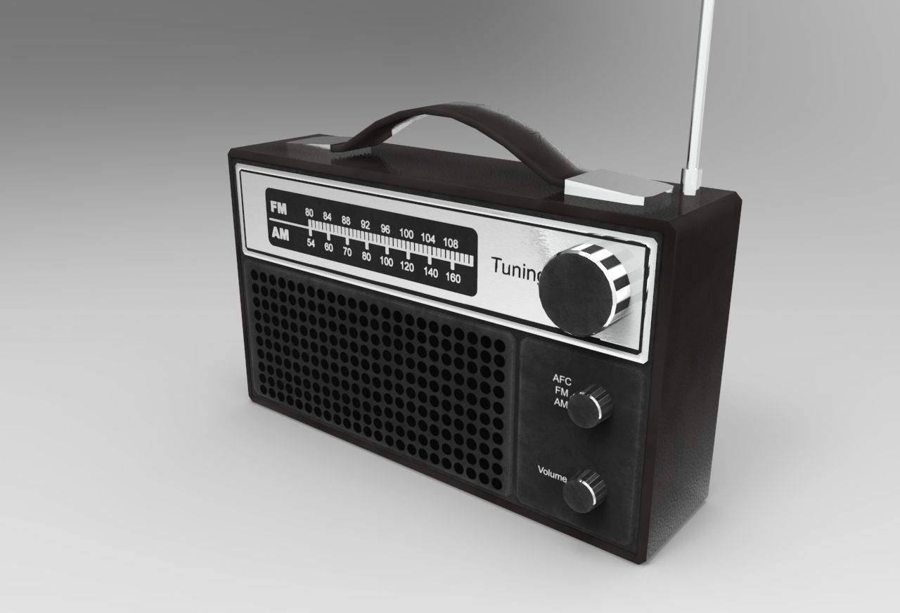
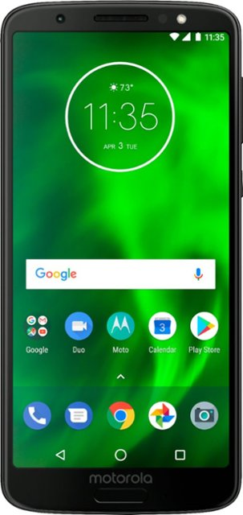
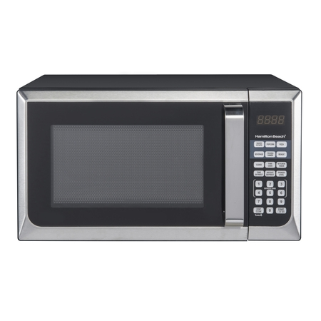

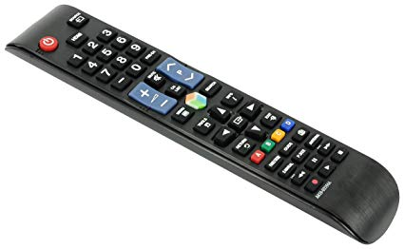
What is this “Radio” thing, anyways?

Slide 3
They all are!
Definition (noun): The transmission and reception of electromagnetic waves of radio frequency, especially those carrying sound messages.
Definition (verb): communicate or send a message by radio.

Slide 4
Signals Intelligence
Signals intelligence (SIGINT) is intelligence-gathering by interception of signals, whether communications between people (communications intelligence—abbreviated to COMINT) or from electronic signals not directly used in communication (electronic intelligence—abbreviated to ELINT).
-- Wikipedia
BUT WHY DO WE CARE???

Slide 5

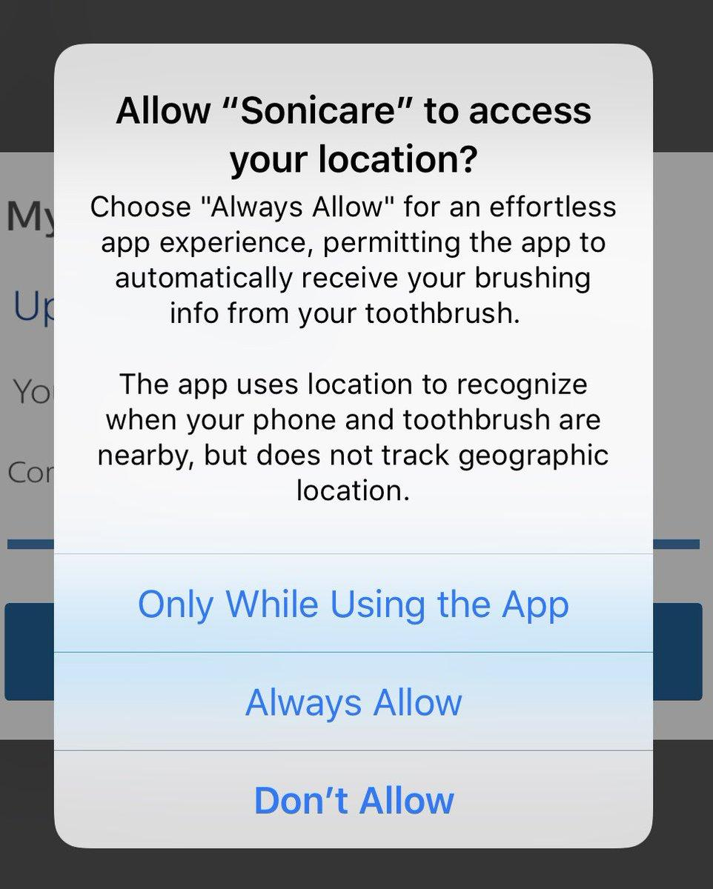


Common household things… Right?

Slide 6
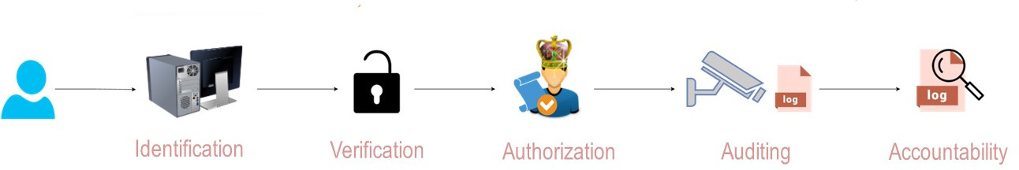
Security? Not if we can get away without it!
How many of these are implemented on radios you own?
Are they secure?
Are you sure???

Slide 7
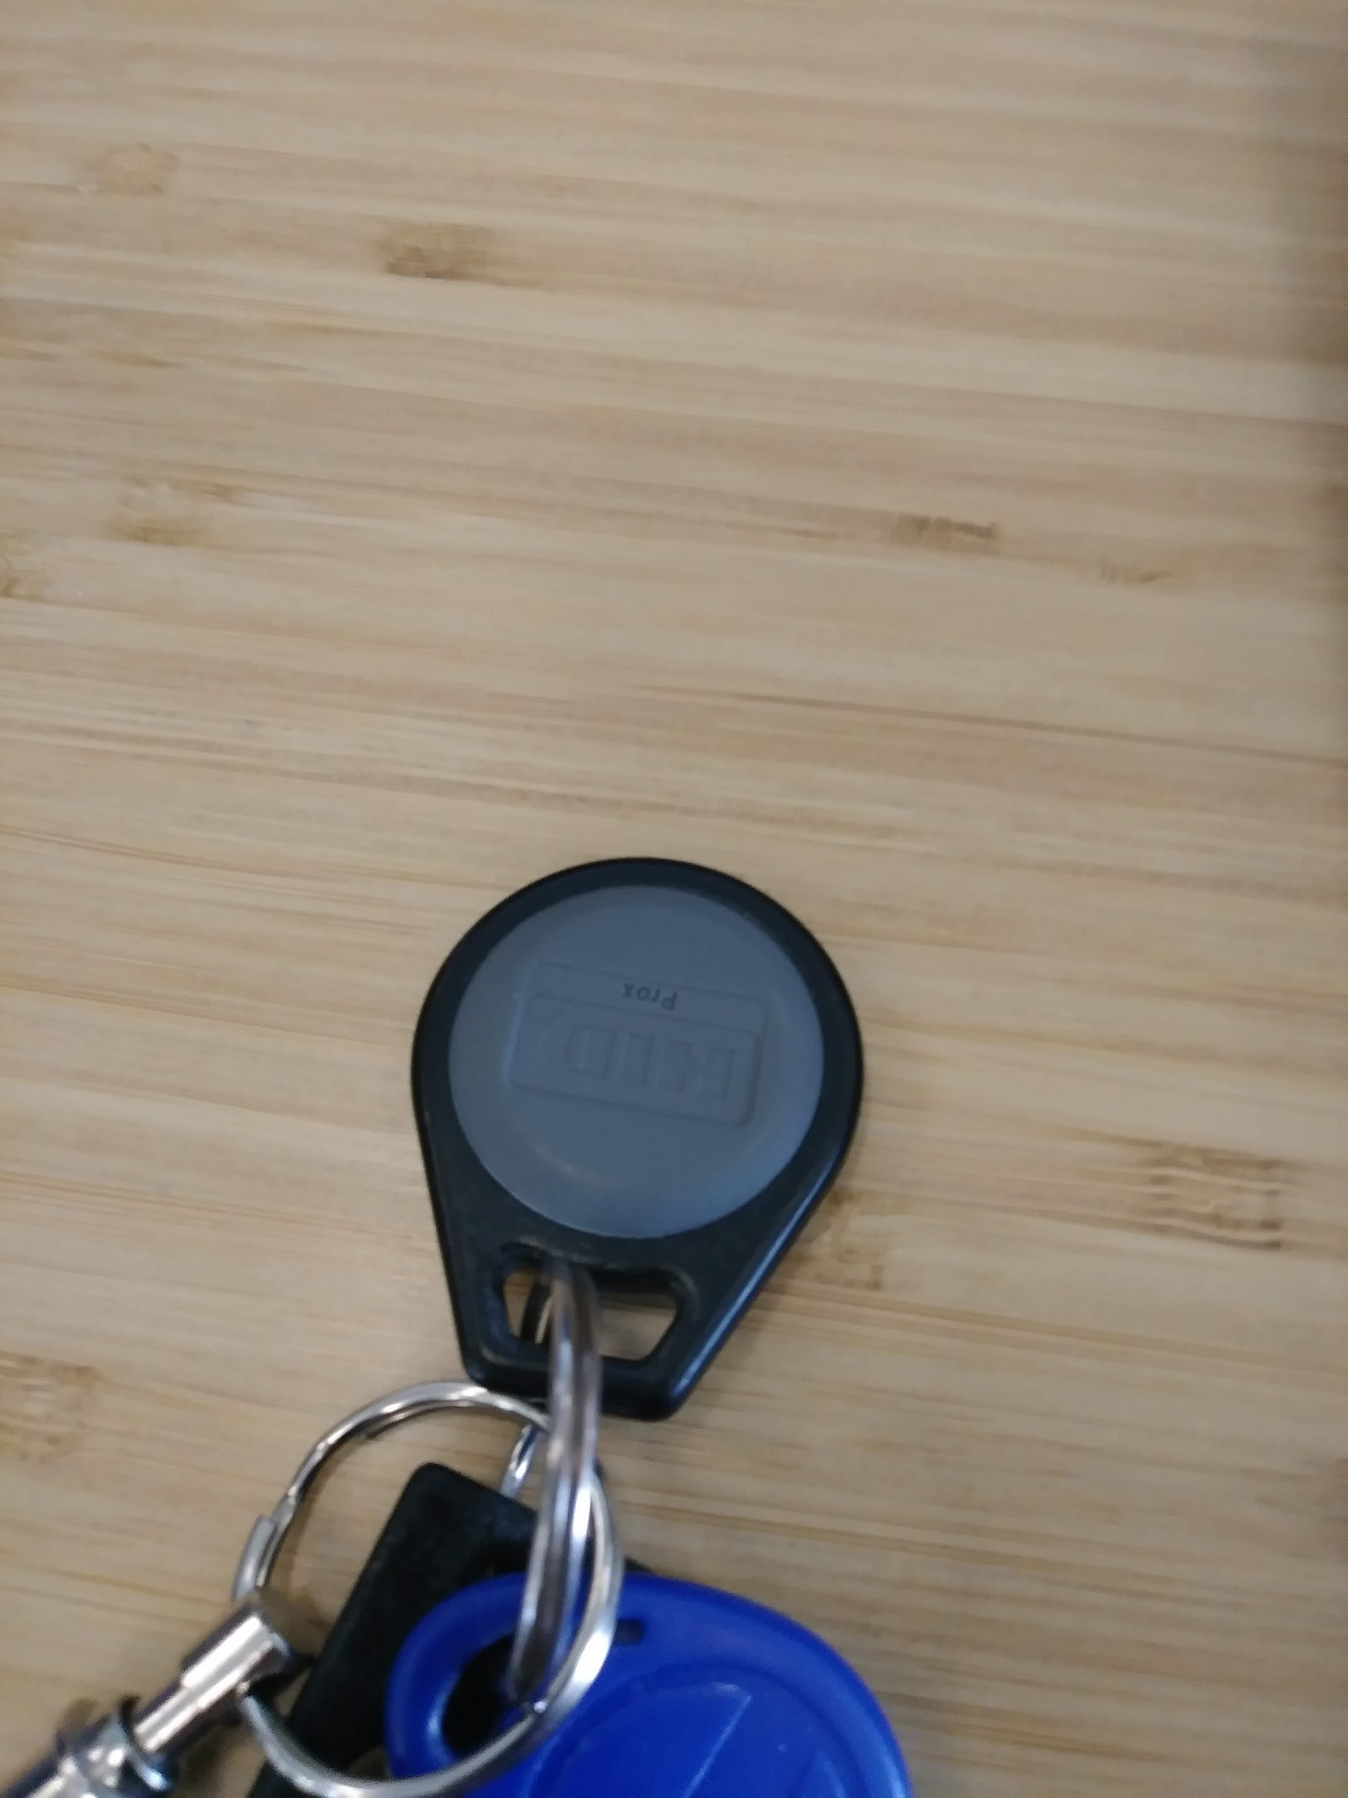
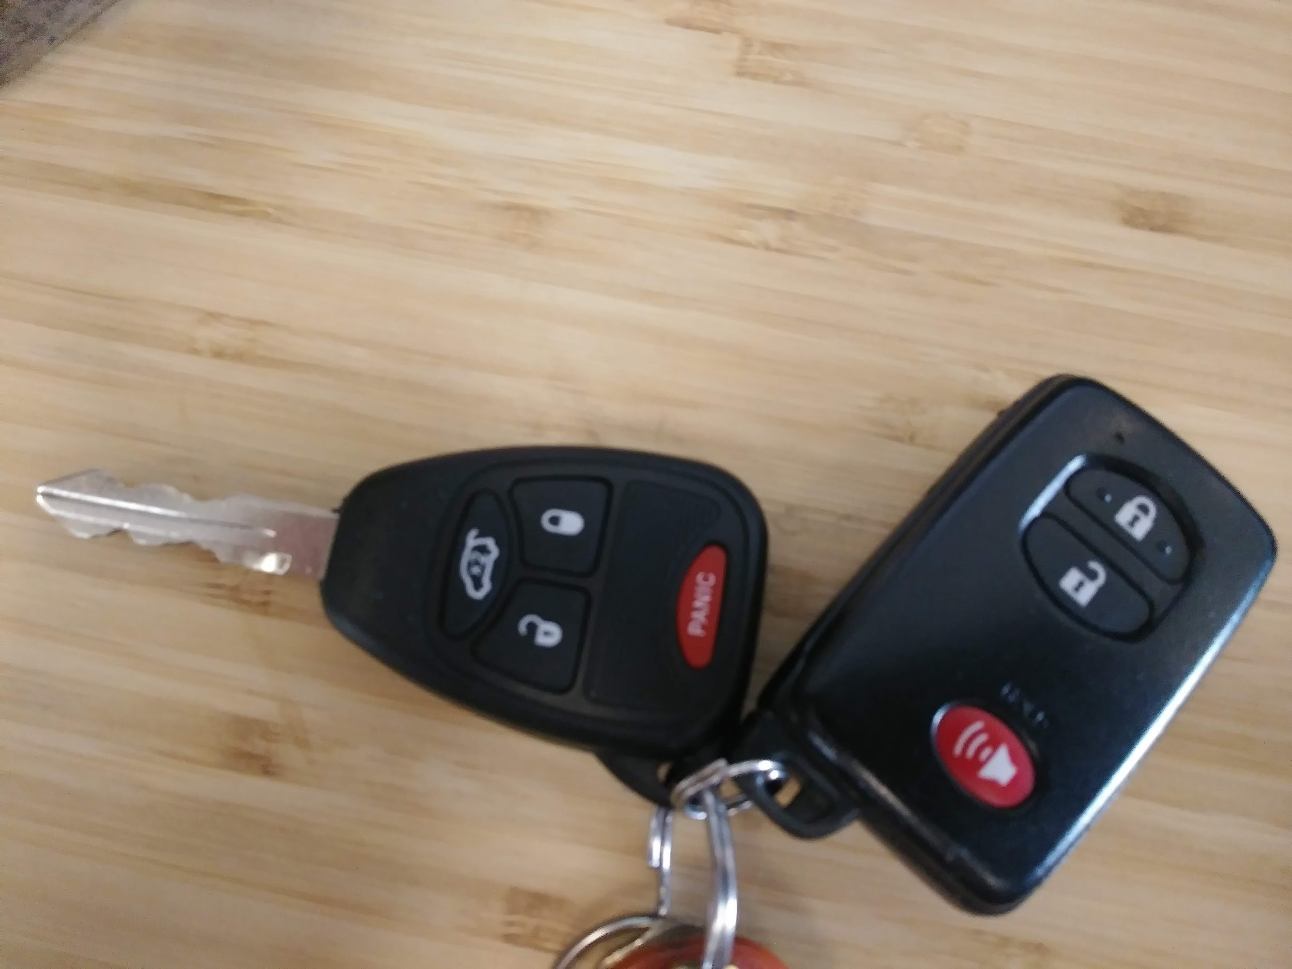
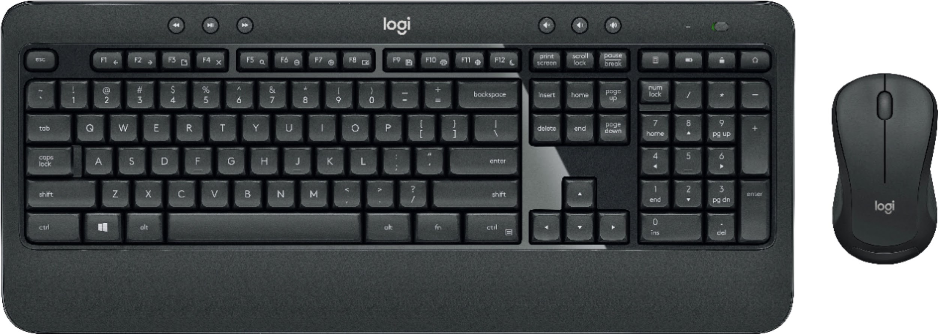
Awareness is Key
… At work

Slide 8


Awareness is Key
… At home

Slide 9

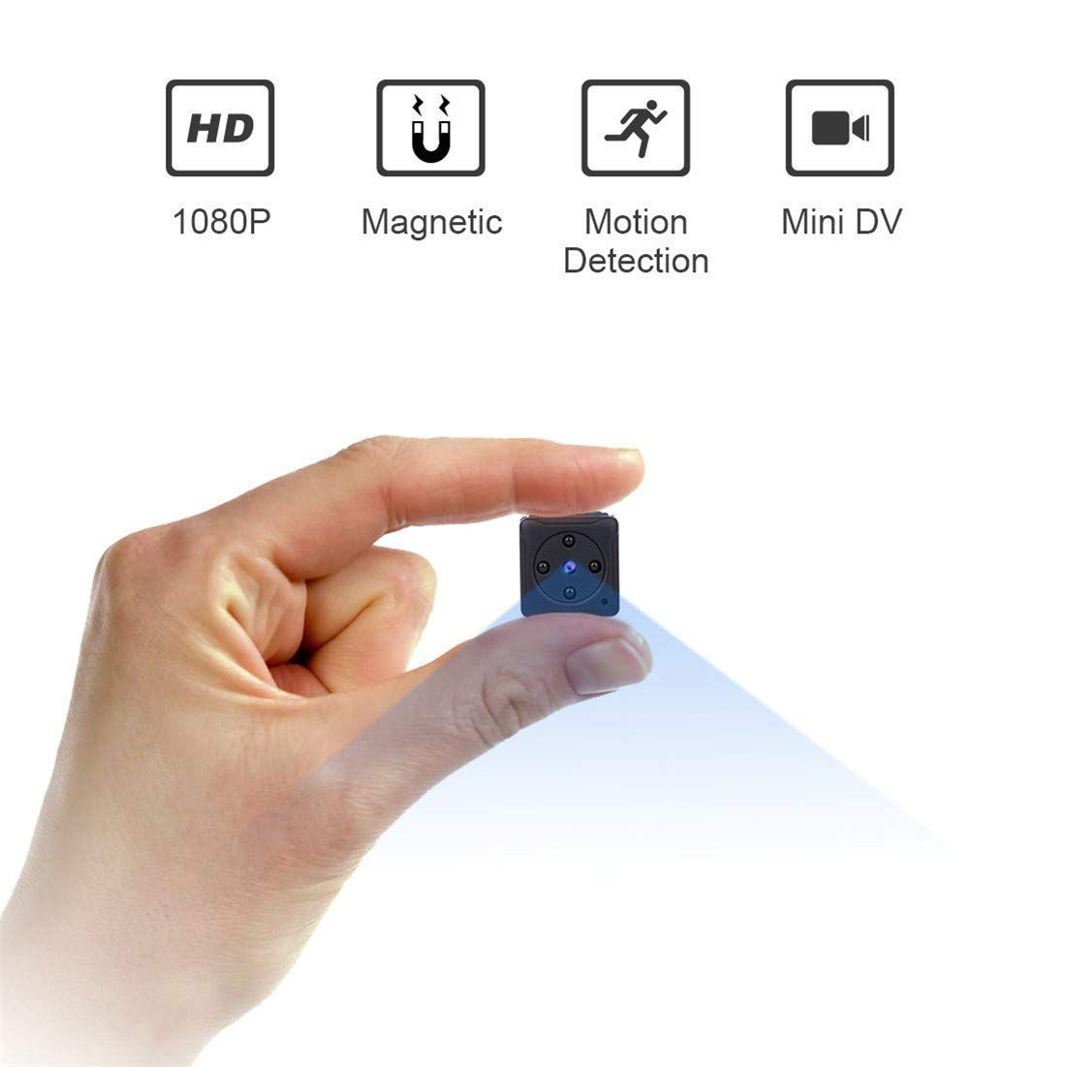

Awareness is Key
… On Vacation
Spycam $37 , Amazon
USB cell spy *cable* $12

Slide 10
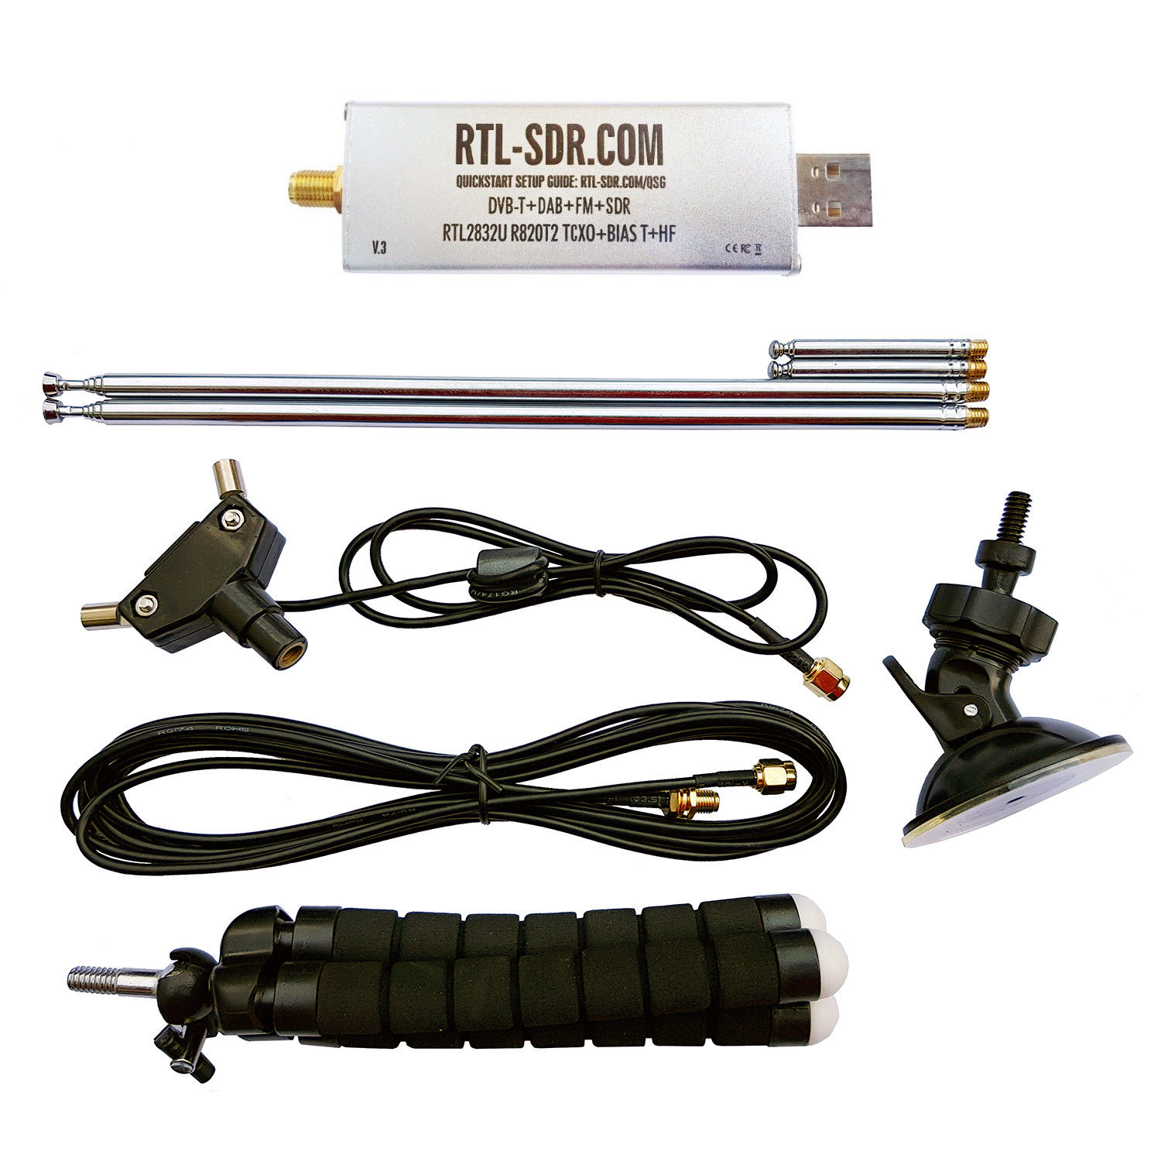
Review of Platforms
RTL-SDR - $20 (avg)
Originally a TV tuner card for Asian TV
Can Receive only 20 MHz-1.7GHz

Slide 11
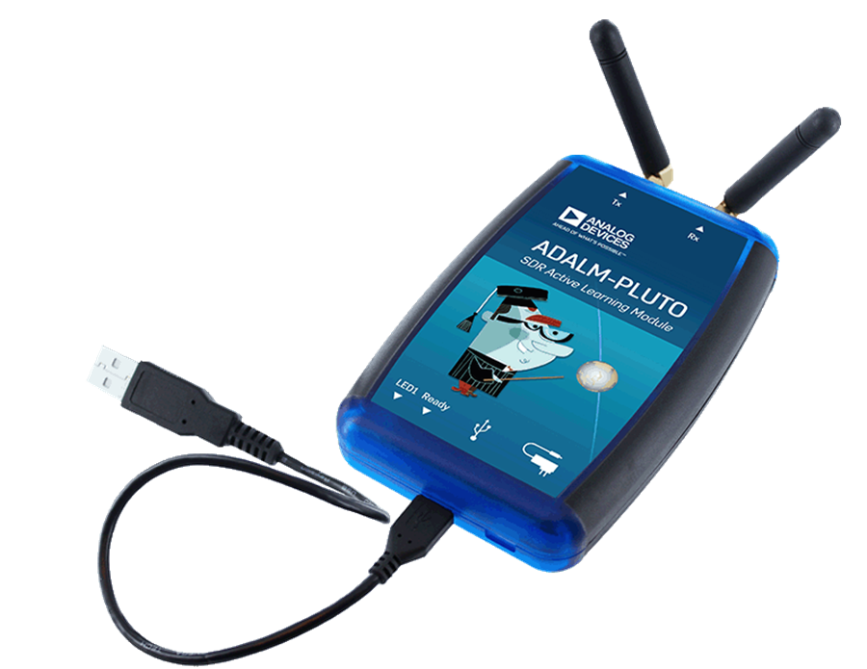
Review of Platforms
ADALM-PLUTO - $100
Dedicated Transmit/Receive Software Radio
Transmit/Receive 70MHz-6GHz

Slide 12
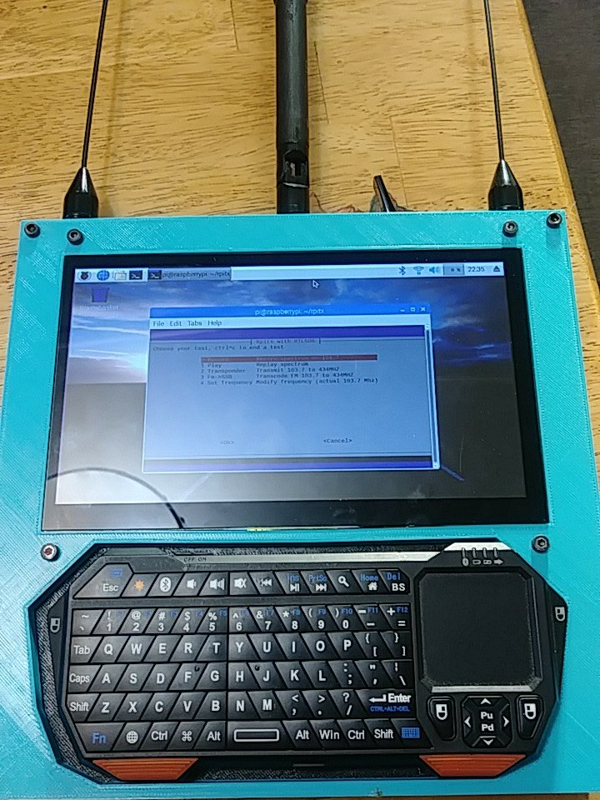
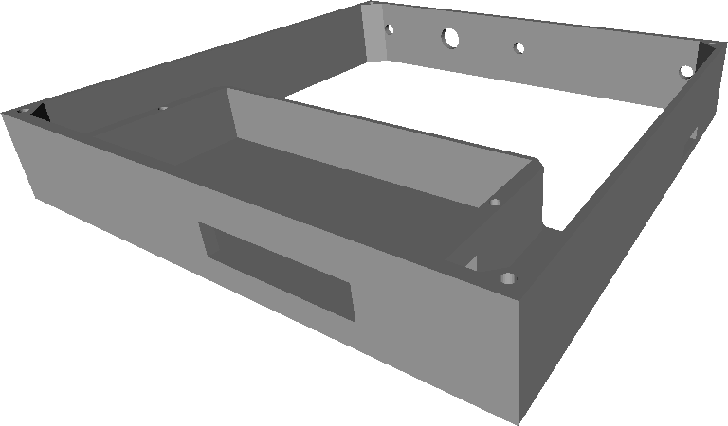
My Platform - A $150 Signals Intelligence Tablet
Raspberry Pi 3 B+
HDMI Touchscreen
RTL-SDR
Keyboard
Cool prints!

Slide 13


Software Whisperer
(OS, Libraries)
RPITX Library RTL_SDR Libraries

Slide 14
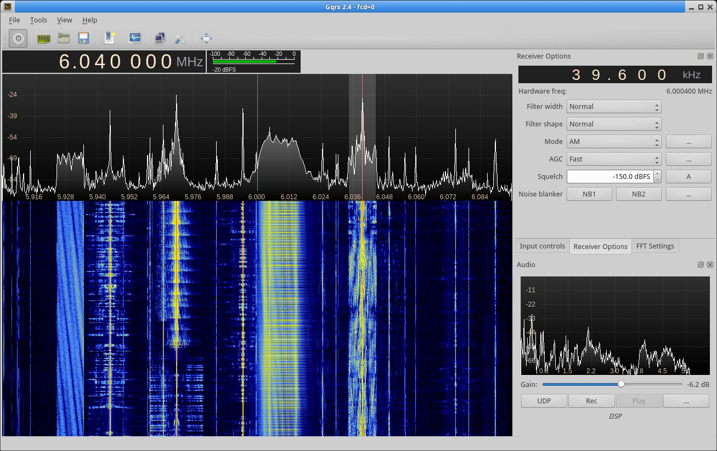
Software / GQRX

Slide 15
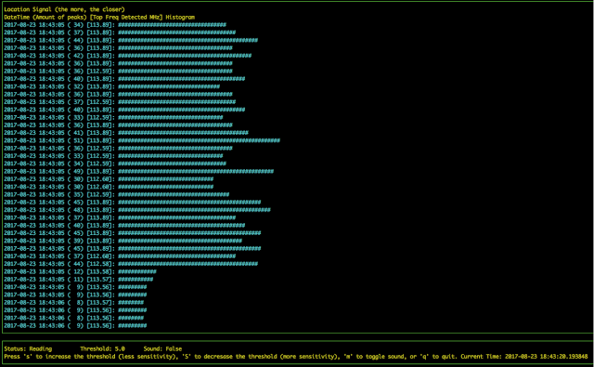
Salamandra - Spy Microphone Detector

Slide 16
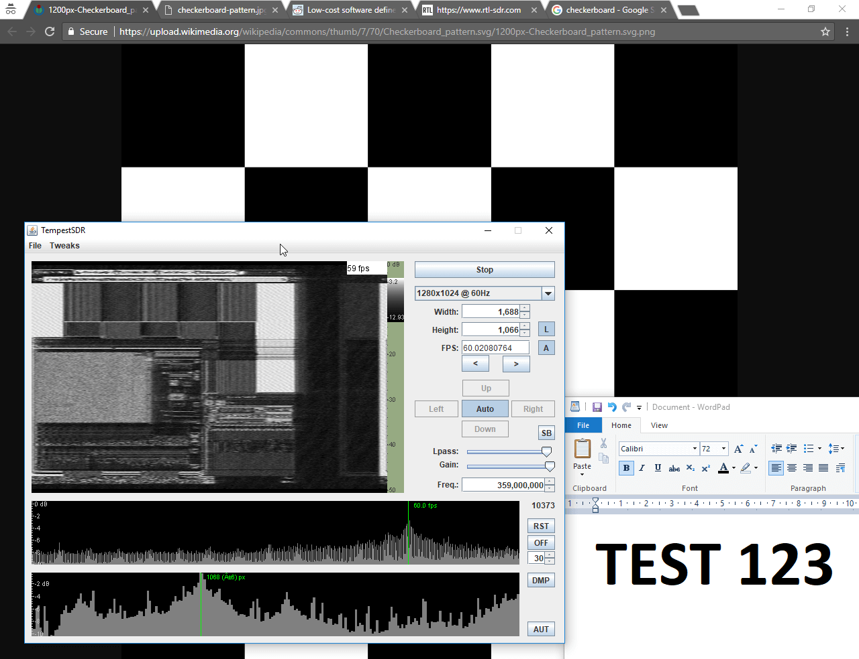
TempestSDR - Every Monitor is Wireless

Slide 17
Demotime….

Slide 18

You want to build one?

Slide 19
RadioInstigator
Signals Intelligence Platform
Josh Conway

